Slide 1
ResumAI Project
Team 4 - Iteration 2 Presentation
Team Members: Amruth, Jaindra, Faizan, Tushar, Shubh, Hemant

Slide 2
UI Developments
Significant UI advancements, including creating main layout of dashboard including theme.
Integrated frontend with backend services across multiple user flows.
Pages developed:
Applicant Analytics
Recruiter Analytics
Profile

Slide 3





UI Developments

Slide 4
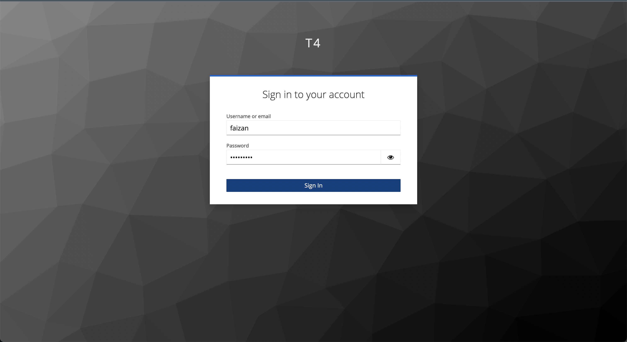
UI Developments
Keycloak auth

Slide 5
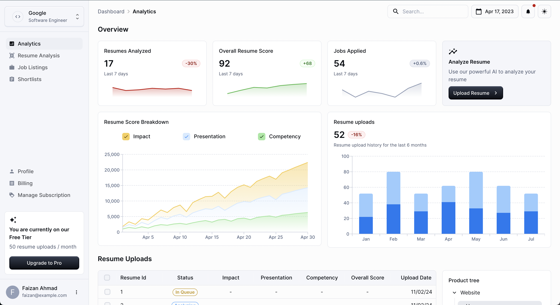
UI Developments
Main Dashboard - Light

Slide 6
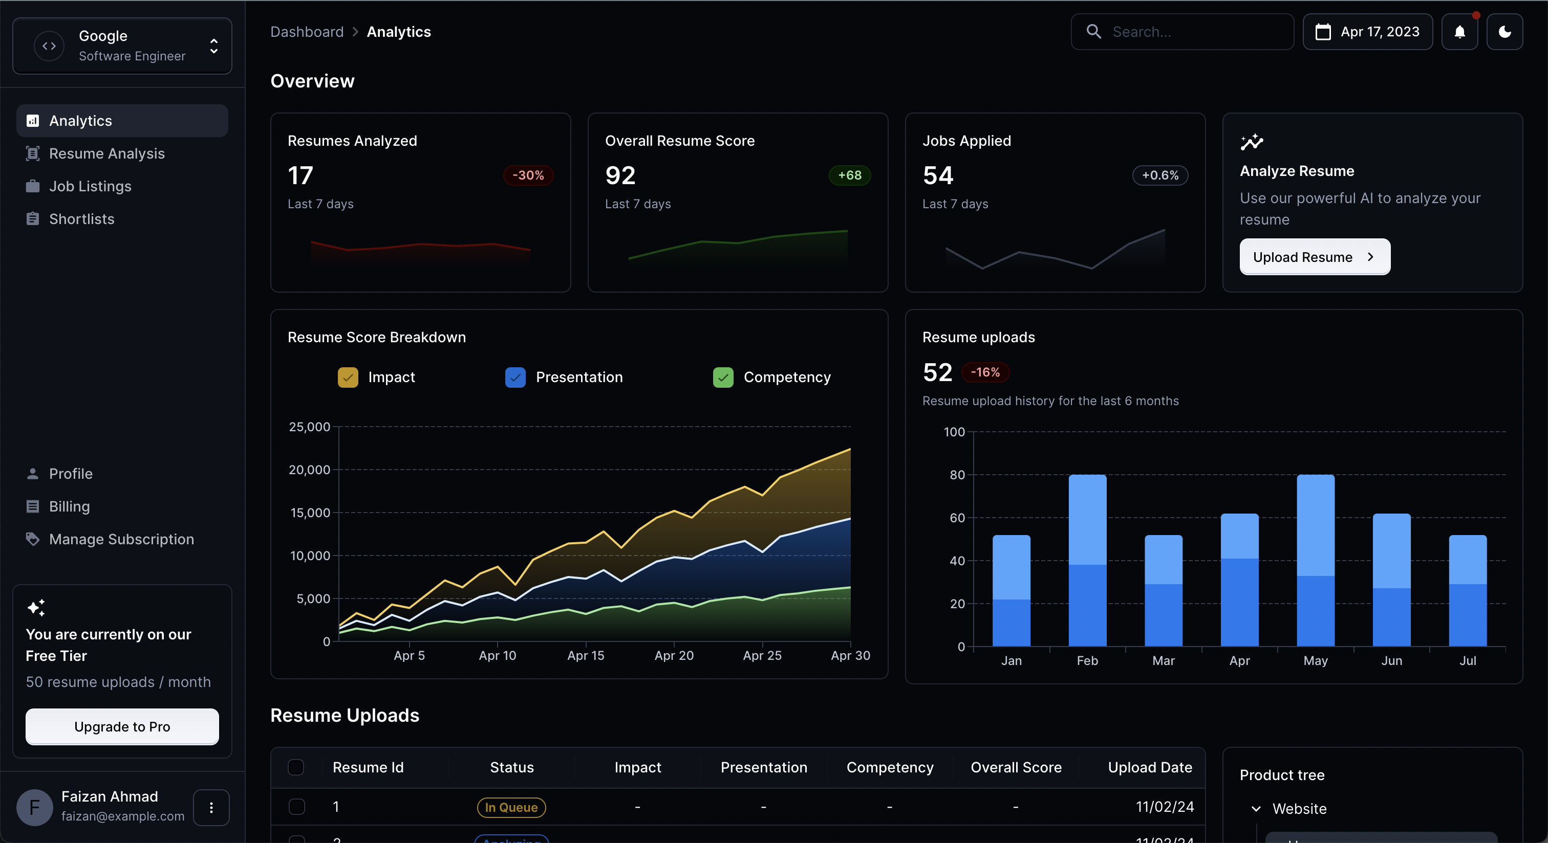
UI
Main Dashboard - Dark

Slide 7
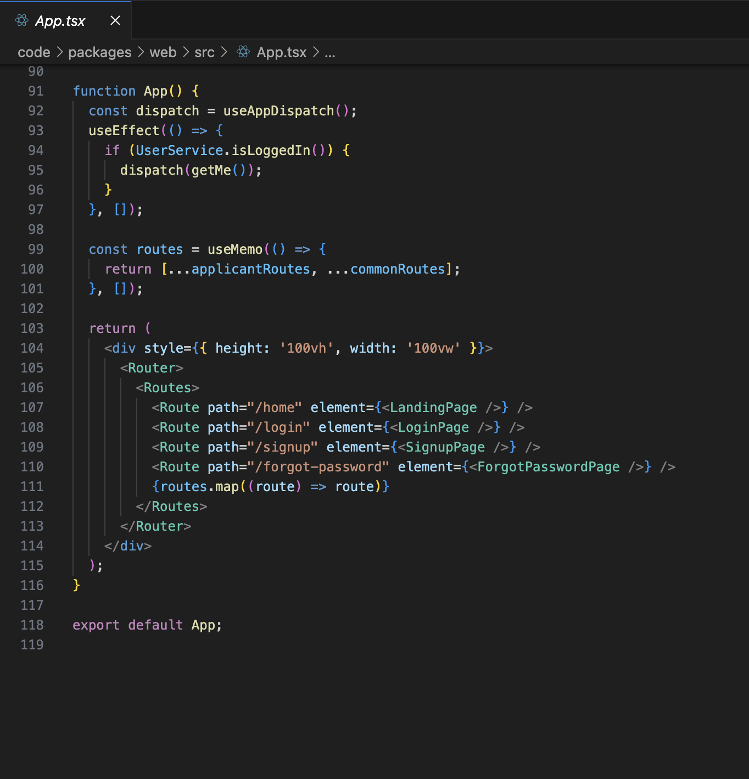
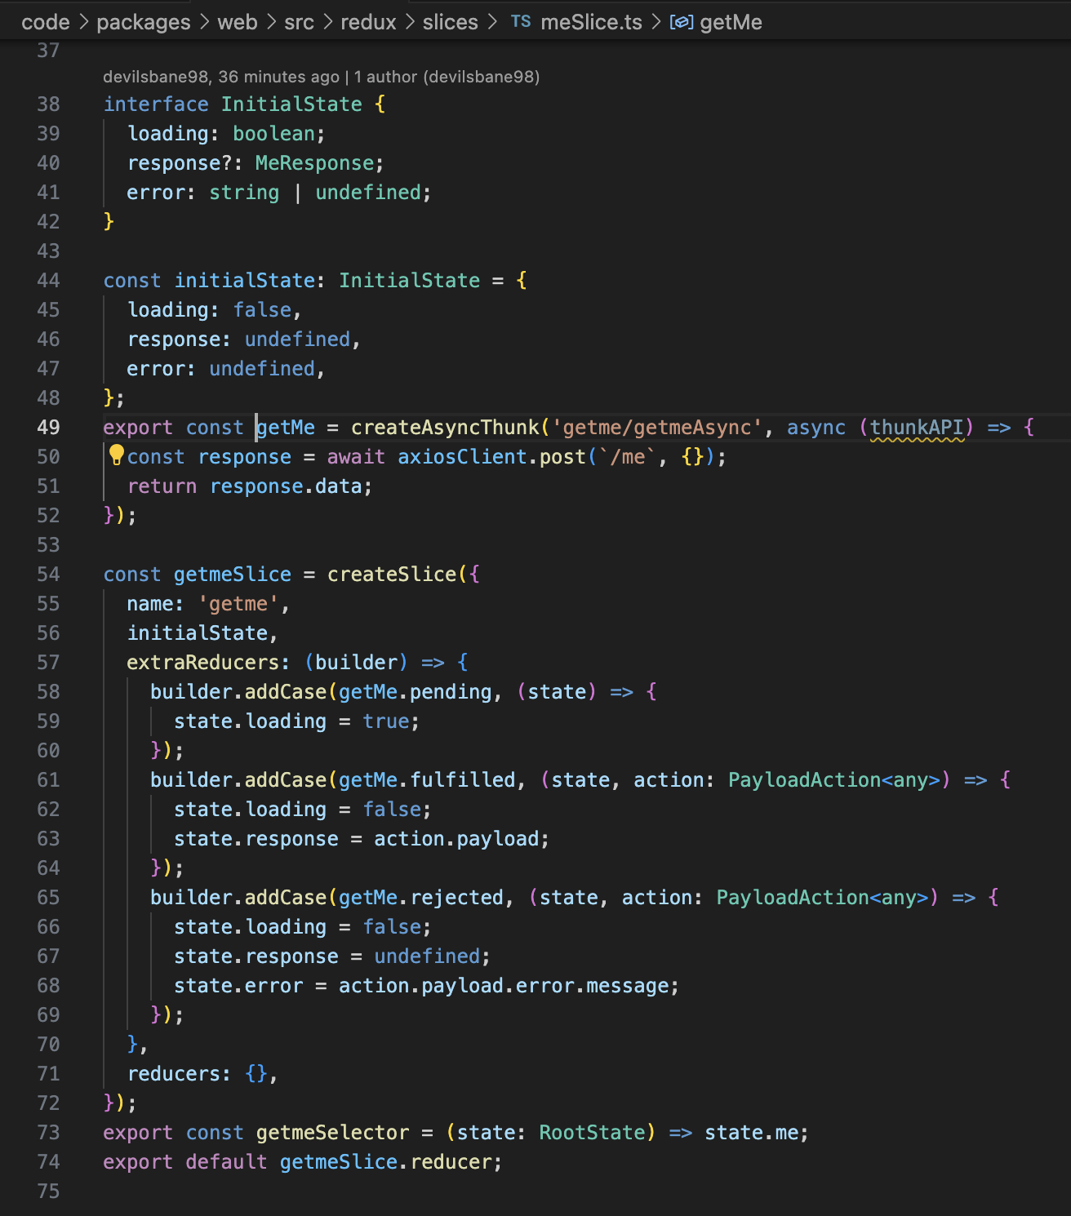
UI

Slide 8
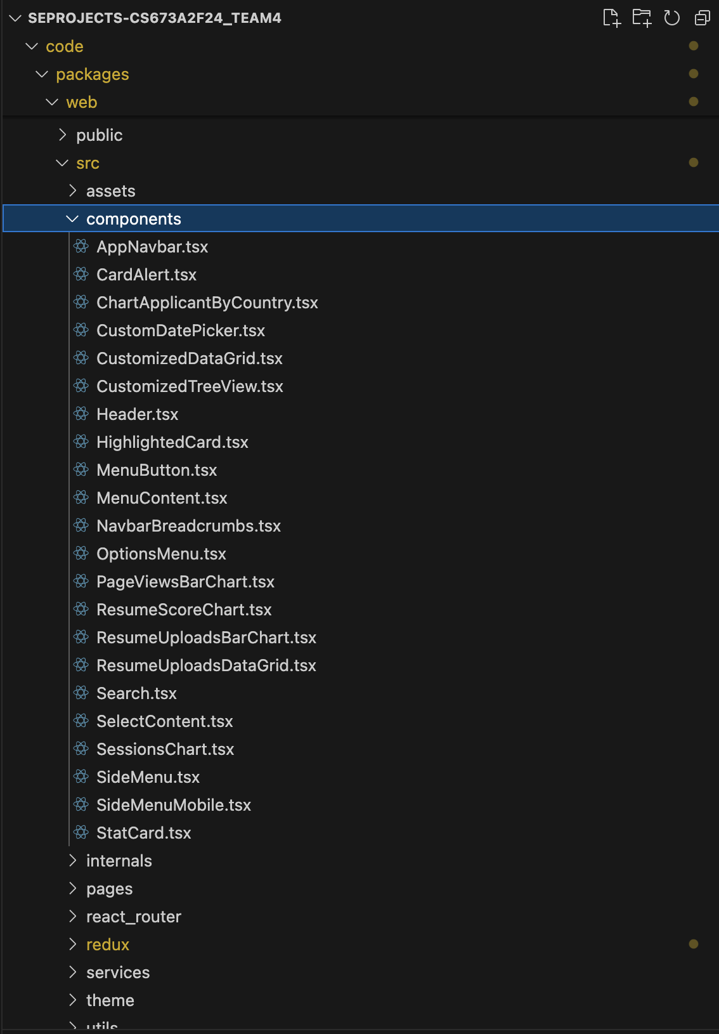
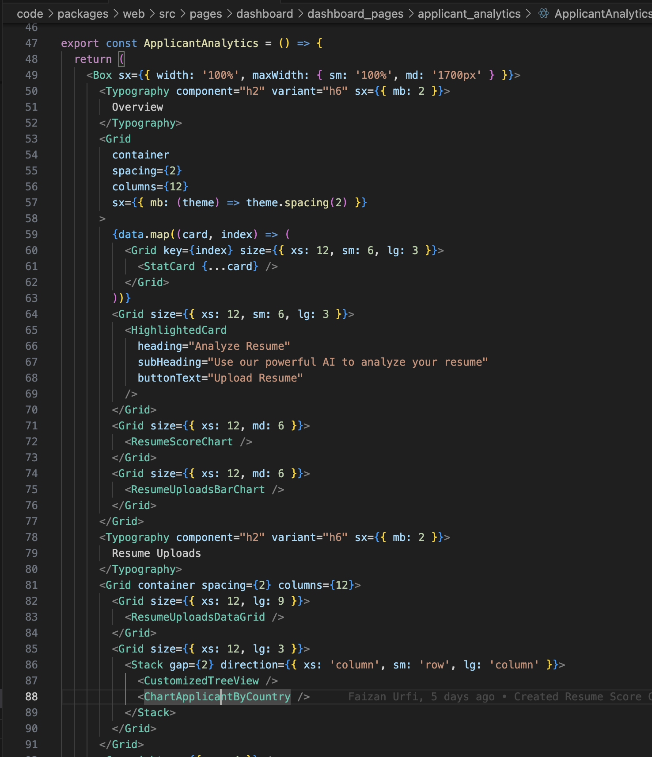
UI

Slide 9
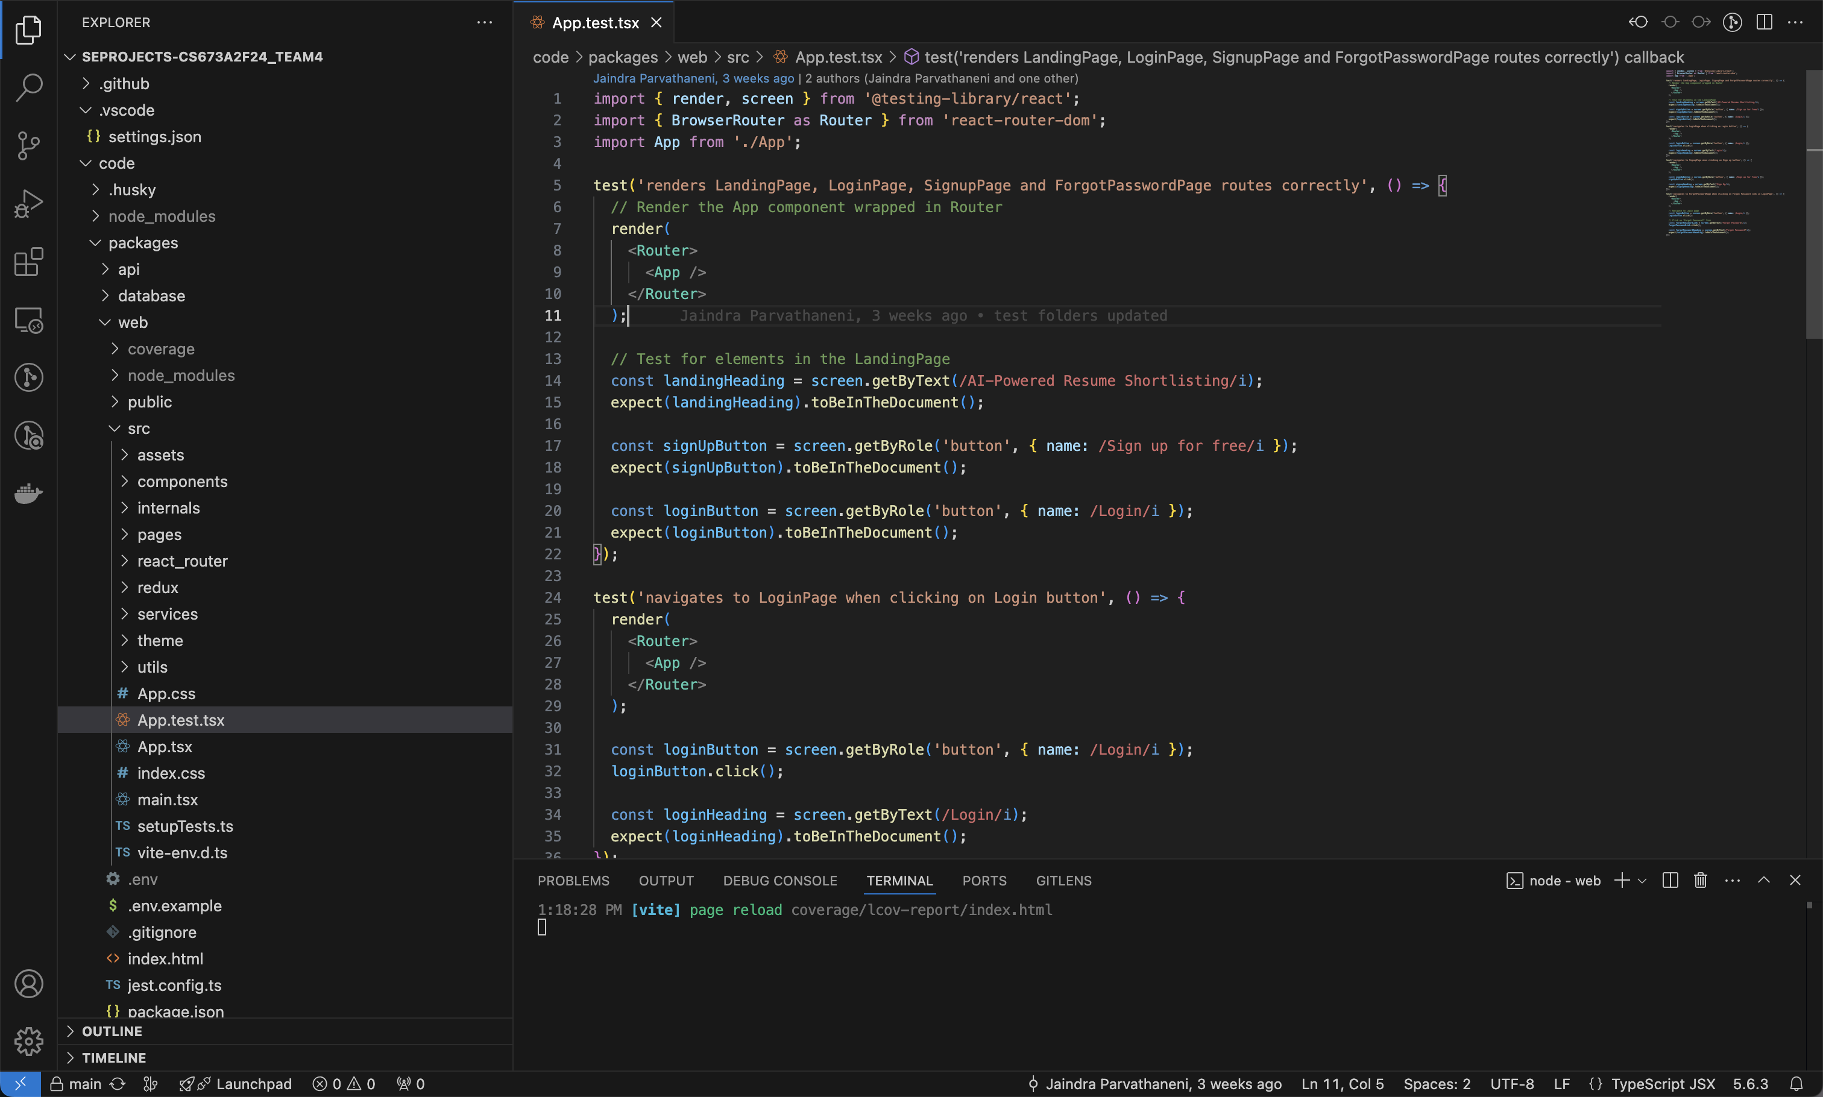
Frontend Testing Junit

Slide 10
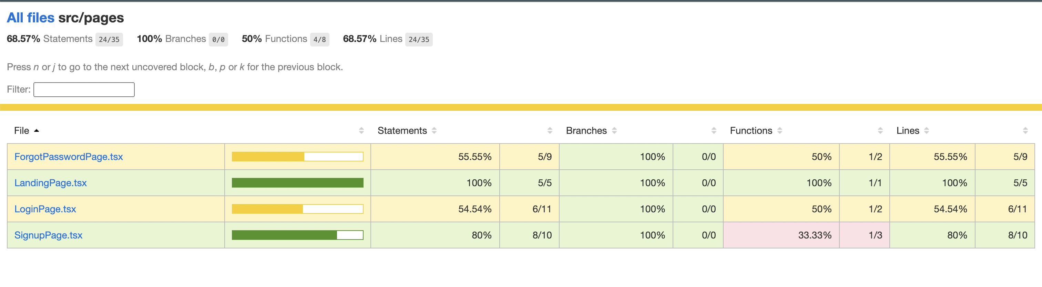
Frontend Testing Coverage

Slide 11







Backend

Slide 12
Backend
CRUD APIs for
Job listing
Application
Resume Upload + Storage
Shortlist
Profile
Authentication through Keycloak including API interceptor

Slide 13
Security and Authentication
- Improved Keycloak security with multi-factor authentication for recruiters.
- Enhanced JWT handling to ensure secure sessions for different user roles.

Slide 14
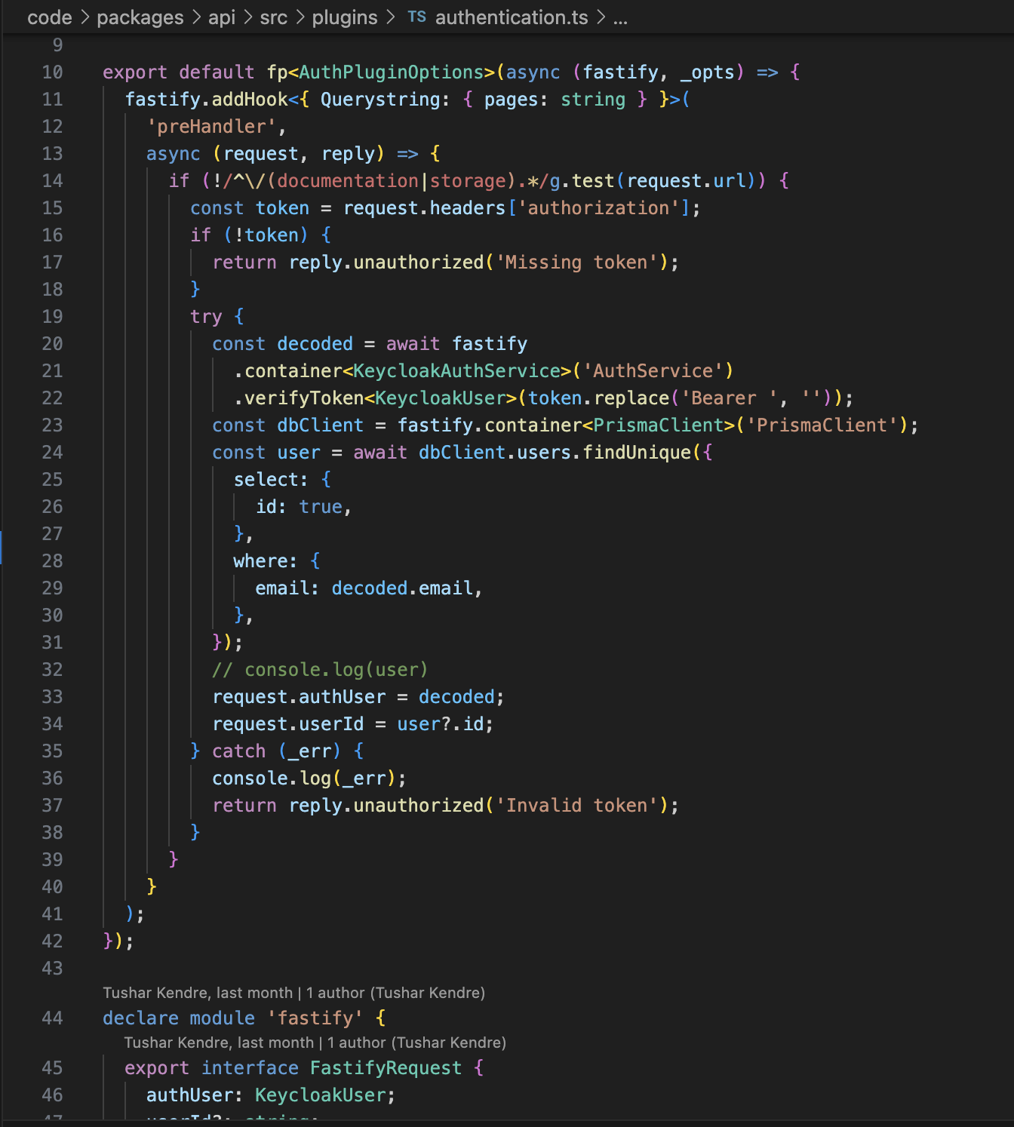
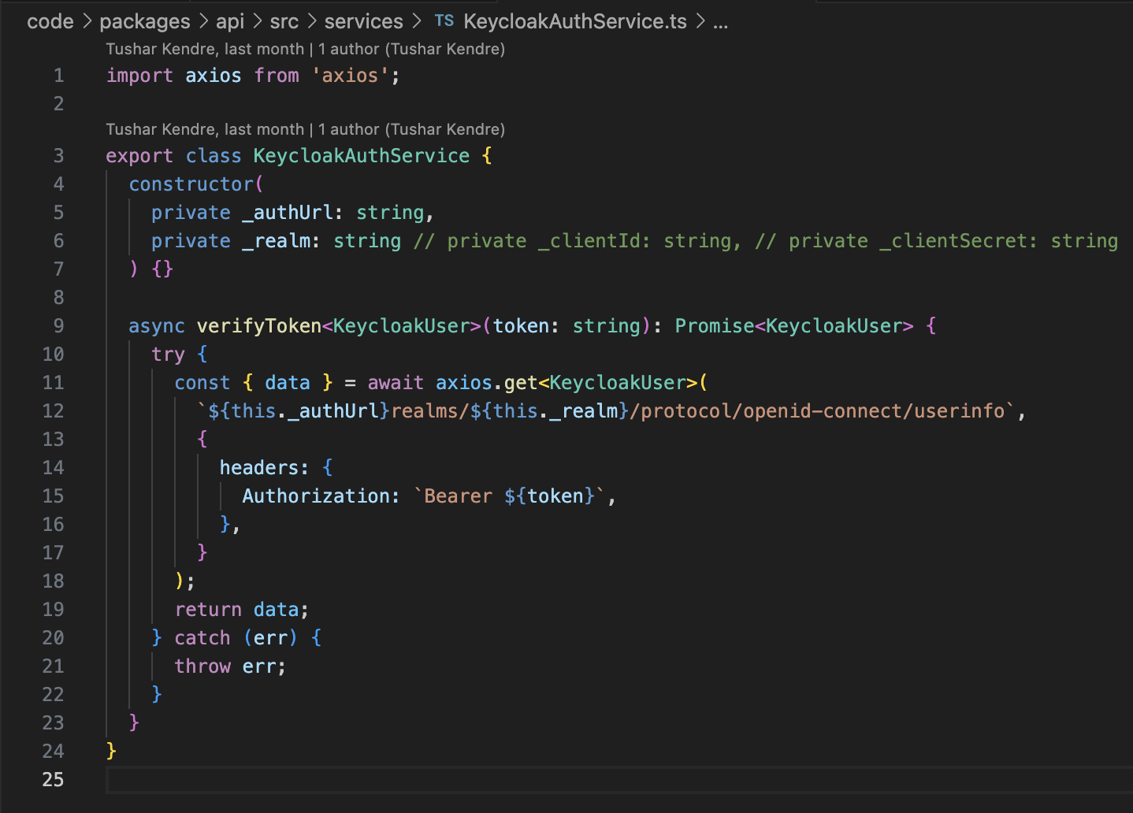
Backend

Slide 15
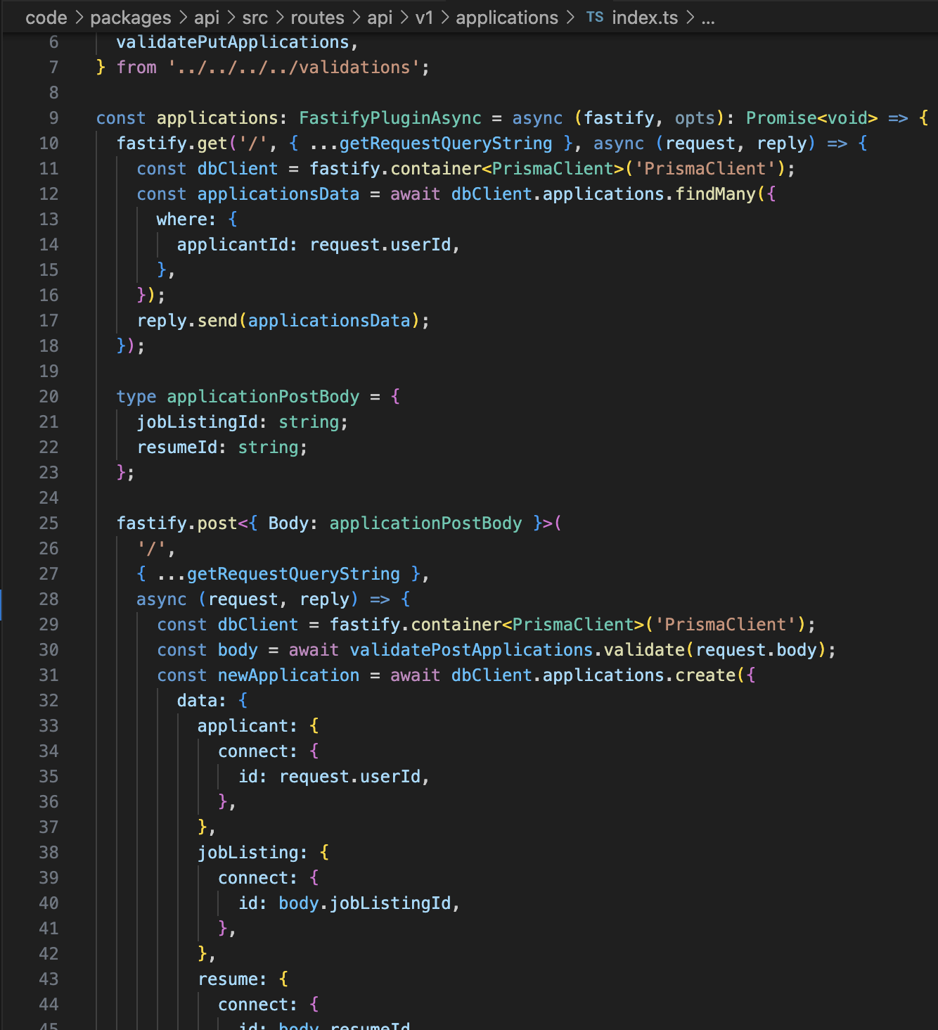
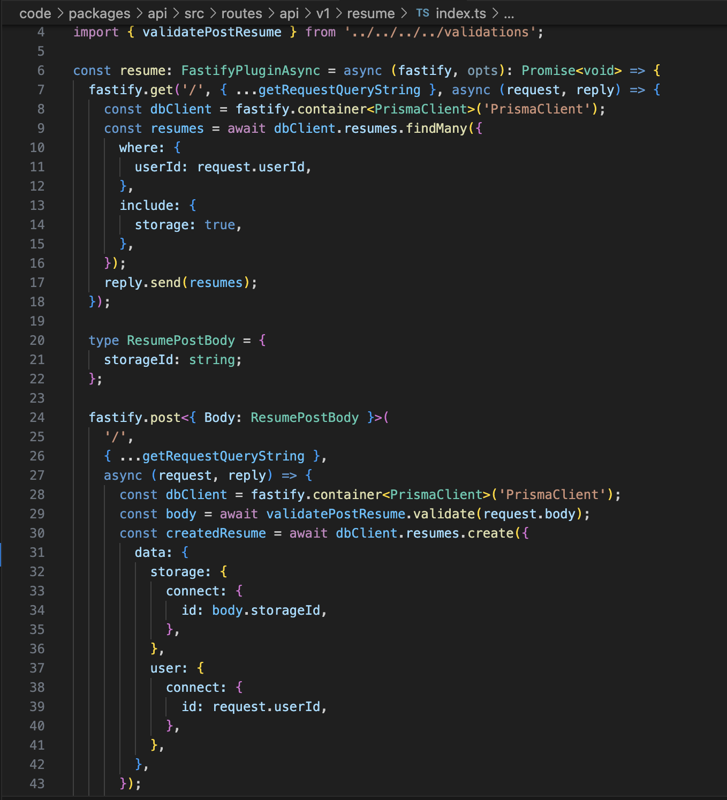
Backend

Slide 16
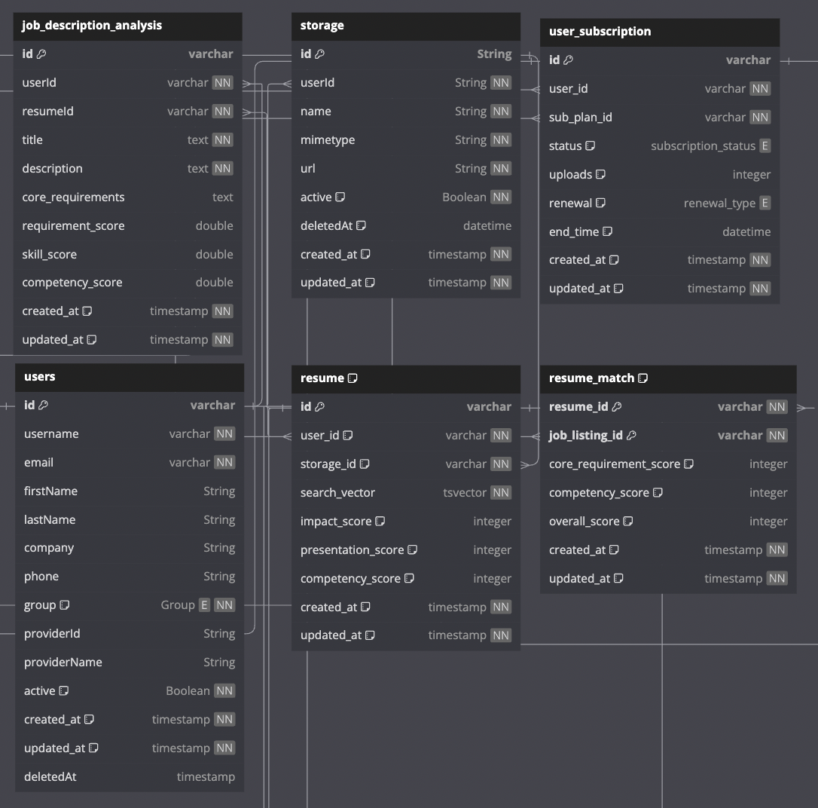
Database

Slide 17
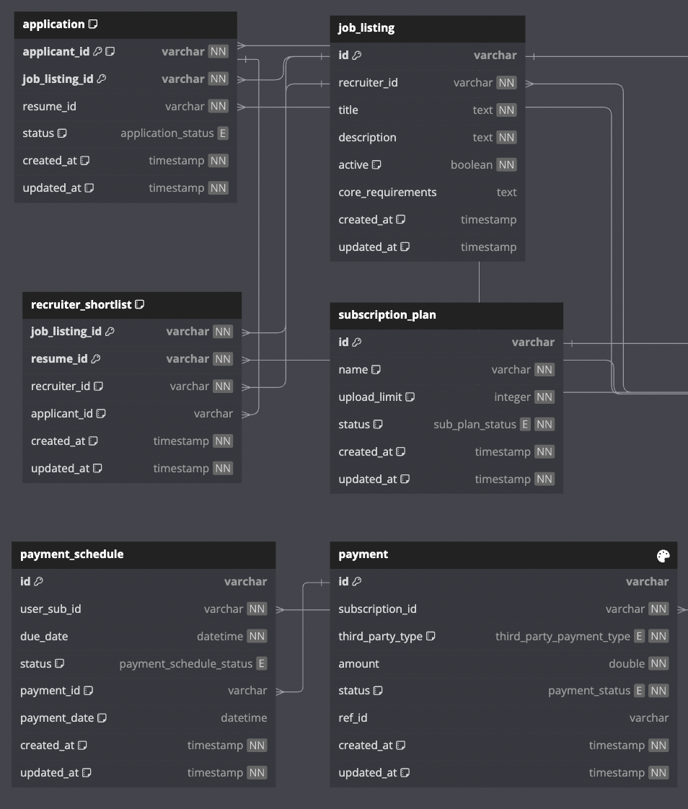
Database

Slide 18
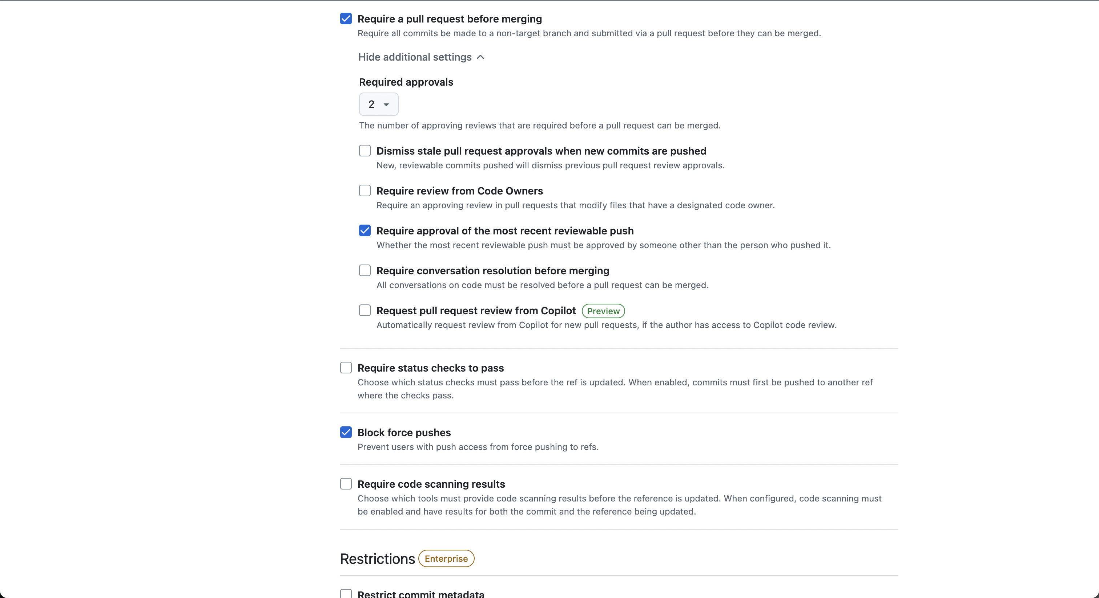
Code Reviews config

Slide 19
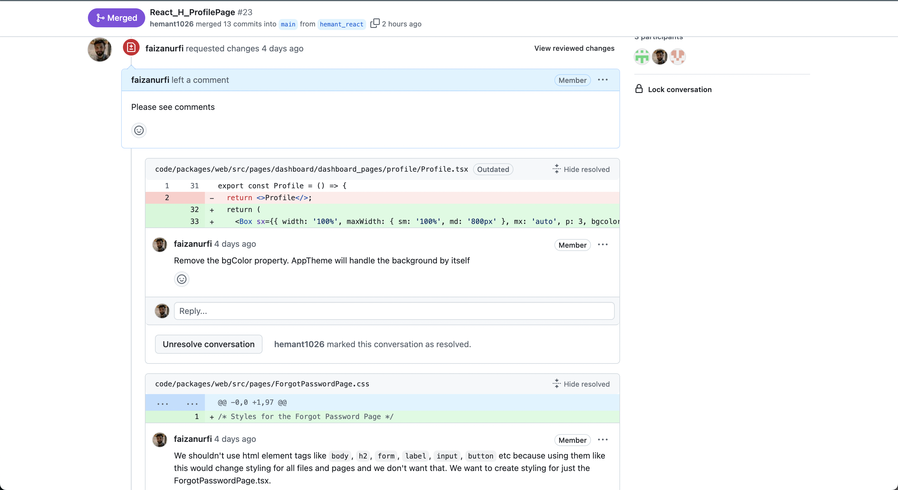
Code Reviews

Slide 20
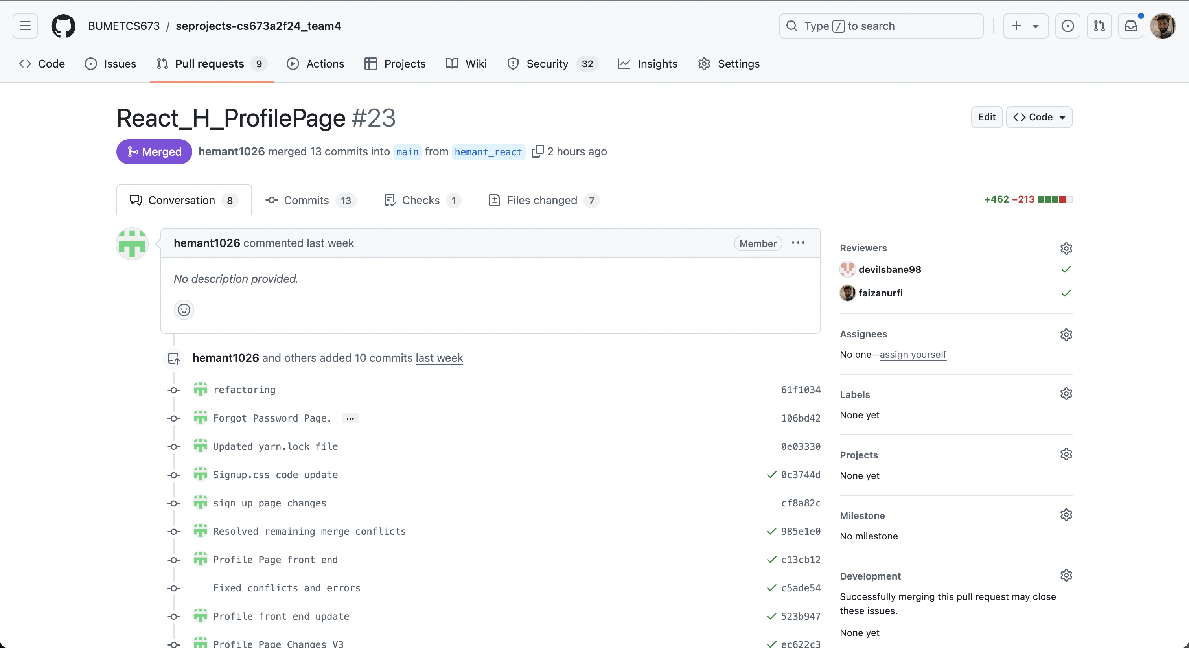
Code Reviews

Slide 21
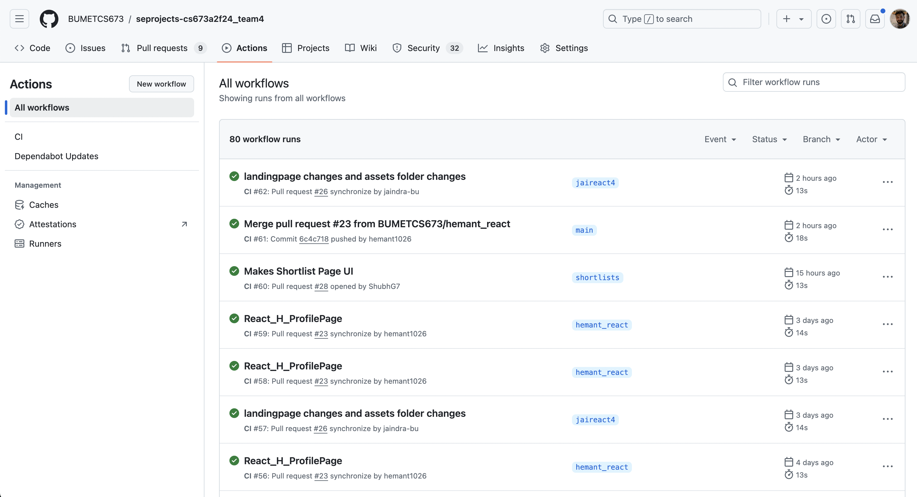
Github Actions

Slide 22



Next CI/CD Plan

